Slide 1

Factors Affecting US Housing Prices in Next Decade
By:
Shubham Patel,
BTech, Mechanical Engineering 2020-24,
National Institute of Technology Kurukshetra

Slide 2
Objectives
To study and understand various factors affecting the housing market of United States
To study the factors in order to understand their importance in deciding direction of housing market for the next decade
To prepare an MECE report of the analysis

Slide 3
Background information
The size of United States’ real estate market was 3.69 trillion dollar in 2021 and is expected to reach 3.81 trillion dollar by end 2022. Its assets make up 20% of global real estate value. It is interesting to note that change in US housing market affects global financial markets as seen in 2008 economic crisis. Hence, an in-depth US real estate market will be beneficial directly or indirectly for any financial firm.
The US housing market is affected by various mutually independent and dependent factors which are discussed in later slides.

Slide 4
Factors affecting housing market
Demographics
Migration
Income
Age
Economy
GDP
Income
Unemployment rate
Inflation
Interest rate
Government Policies
Subsidies
Taxes & Benefits
Other factors
Housing location
Housing architecture

Slide 5
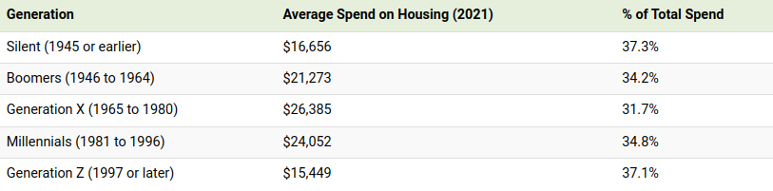
DEMOGRAPHICS
The Demographic factors affecting house price are migration, difference in priorities between generations and income difference between generations.
For example, have a look at income and housing spending by generation. Though the amount spent by GenZ on housing is less, but it is more, if we compare by % of total amount spent. Which displays more upcoming interest in housing in the future.

Slide 6
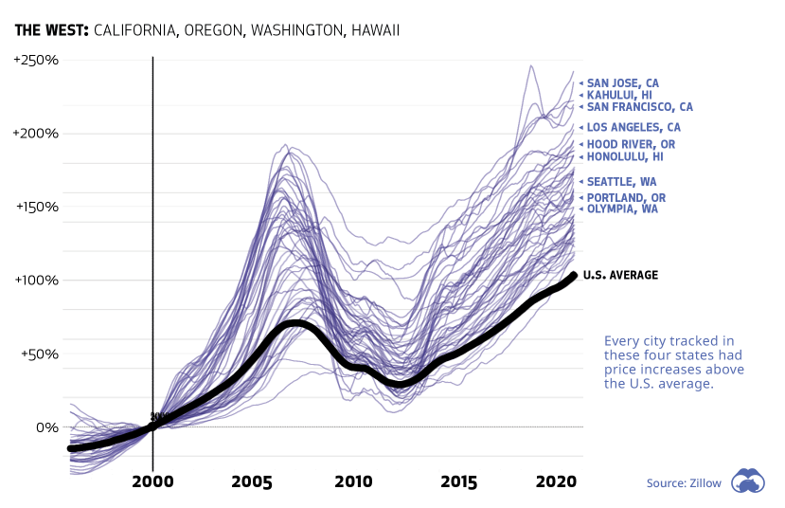
NOW, HAVE A LOOK AT THE EFFECT OF MIGRATION ON HOUSING MARKET
An example of migration is West migration. More and more Americans have shifted towards West Coast due to New opportunities at Silicon Valley. This migration has caused a huge demand of houses in West Coast and especially in California.
The effect on housing market can be clearly seen in the shown graph, the housing market of West Coast has increased around 150-200% compared to US national average of 100%.

Slide 7
Economy
Economy is a very crucial factor affecting housing market at the macro level.
Change in mortgage interest rate directly impacts the housing market. If the interest rates are low, then the buyers will be encouraged to buy house and demand will increase.
Other economic indicators like GDP and income per capita are directly proportional to price and demand of houses.
While some economic indicators like unemployment rate and inflation are inversely proportional to demand of housing.

Slide 8
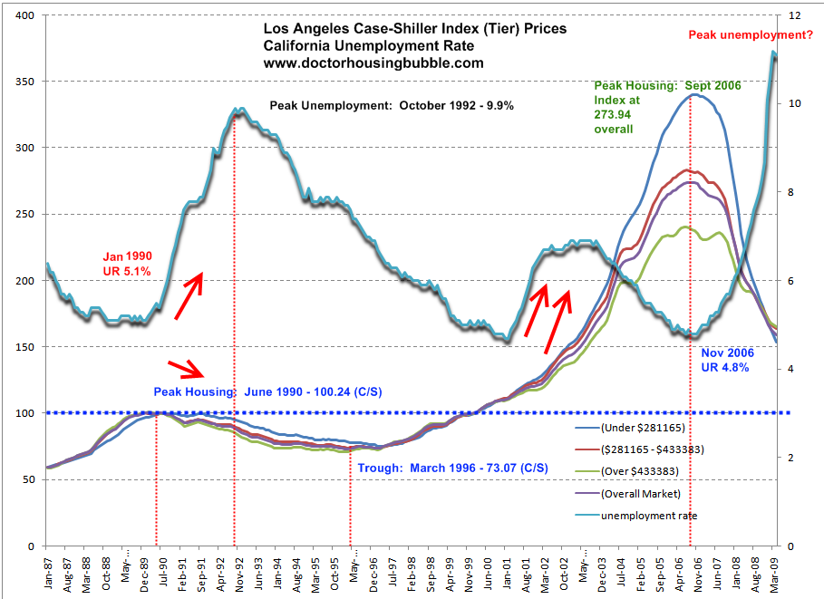
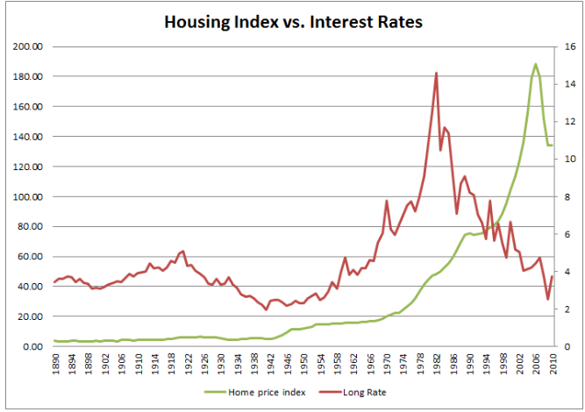
Checkout relationship between various economic terms and housing market
Housing index vs Unemployment rate
Housing index vs Interest rate

Slide 9
Government policies
Government policies affect housing market in their own unique way. One good example of this is the home loan encouragement during 2005 to 2008 which lead to loans to people with bad credit score and ultimately financial crisis.
Laws like Rent control, condo conversion regulations, landlord-tenant laws, restriction on building height affects housing demand and indirectly housing market in their own unique way.
Other government policies like capital gains tax and subsidies also affects housing market.

Slide 10
Other factors
The miscellaneous factors which can't be classified into any of above category comes under this category. They mostly affect the housing market at micro level.
This factors include area location of house, house architecture etc.
The real estate market is very influenced by location (it can be city, state or a neighborhood) due to various opportunities and facilities which comes with the location.
The architecture of houses can also be an important factor in housing market. The construction of condos can bring down the demand of houses as they can provide houses to more people with an expense of less area; while construction of luxury houses can increase the price of nearby neighborhoods due to influence.

Slide 11
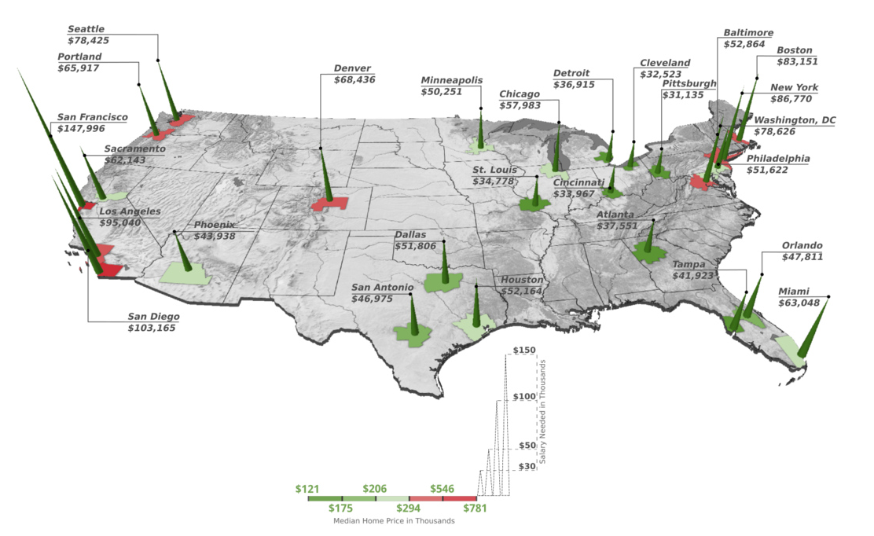
Checkout the price difference due to location in various cities of USA

Slide 12
summary
This report provides a high level overview about all the factors who can affect the housing market of the United States over the next decade. As the report suggests, various factors affect the housing market at a macro level while some affect it at a micro level. Nevertheless, by studying and analysing all the factors, the future direction of housing market can be predicted very accurately.

